Slide 1
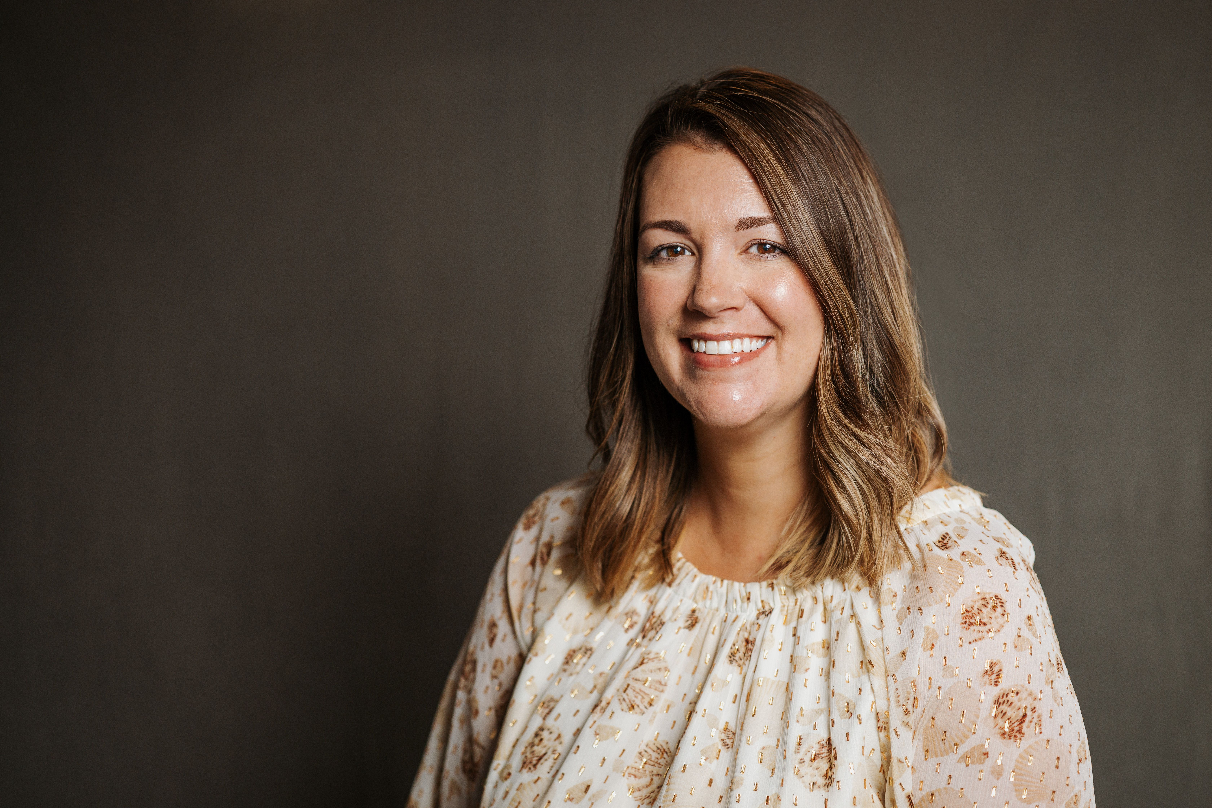
Shelby Oravets Associate Consultant — Acceleration
Email
shelby.oravets@thebridge.com
Location
Lorain, Ohio
Mobile
(440) 371-7291
Shelby, a Healthcare Supply Chain Professional, joined The Bridge in June 2024 with 5+ years specializing in patient-facing clinical care, supply chain procurement, patient billing, and operational support. Passionate about helping others achieve their goals.
EXPERIENCE
Industry Experience
Healthcare | Sports Management | Volunteer Management | Hospitality | Customer Service
Healthcare Consultant - Memorial Sloan Kettering Cancer Center, UCHealth, Oregon Health Sciences University
Facilitate support and research to implement efficient Supply Chain operations.
Create and organize deliverables to encourage purchasing efficiency.
Collaborate and communicate amongst client staff to promote vendor contract status.
Occupational Therapy Assistant
Provide substantial documentation and billing processes via Epic and NetHealth systems to allow for proper reimbursement.
Deliver quality treatment sessions that offer appropriate challenge and encourage overall progress.
Collaborate with team members to promote effective and timely services and techniques to best fit the patient.
Implement patient goals to encourage independence and overall quality of life.
BACKGROUND
Functional Skills
Excellent Organizational and Time Management Skills, Strong Analytical and Problem-Solving Abilities, Effective Communication and Interpersonal Skills, Attention to Detail and Accuracy, Ability to Work Under Pressure and Meet Deadlines, Adaptability and Flexibility in a Dynamic Work Environment.
Qualifications

Slide 2

Email
shelby.oravets@thebridge.com
Location
Lorain, Ohio
Mobile
(440) 371-7291
Shelby, a Healthcare Supply Chain Professional, joined The Bridge in June 2024 with 5+ years specializing in patient-facing clinical care, supply chain procurement, patient billing, and operational support. Passionate about helping others achieve their goals.
Shelby Oravets Associate Consultant
Acceleration

Slide 3










 | USE OVER DARK BACKGROUND | USE OVER LIGHT BACKGROUND
STRATEGY & ADVISORY
DATA & AI
EXPERIENCES
CLOUD & PRODUCT
ACCELERATION

